Slide 1




DATA ANALYSIS IN
LOS ANGELES COUNTY:
INSIGHTS FOR HOSTS
Albert Delgado
Tremon Everett
Angel Garcia
Nick Perez
Jessica Salazar
Jocelyn Salazar Andrade
California State University, Los Angeles
BUS 5100-93: Intro To Business
Dr. Jongwook Woo

Slide 2
Abstract
Retrieved From: Inside Airbnb
Dataset Size: 86.4 MB
Focus: Los Angeles County
Objective:
By utilizing charts and comparisons, we aim to provide insight and recommendations for hosts to set competitive prices while enhancing the appeal of their listings to guests.
Dataset contains:
Property Location
Type
Capacity
Amenities
Pricing
Booking Frequency
Guest Ratings

Slide 3
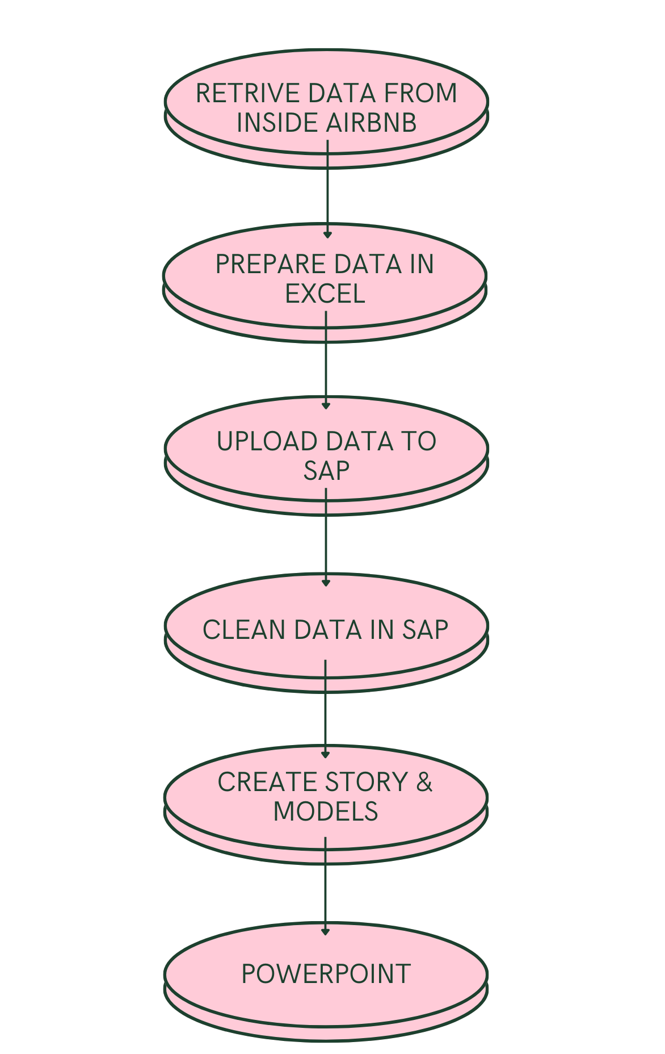
Implementation Flowchart

Slide 4
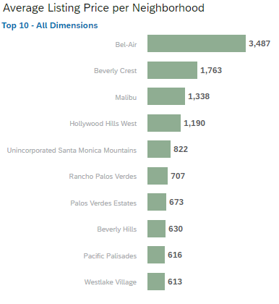
Bar Graph: Average Listing Price per Neighborhood

Slide 5
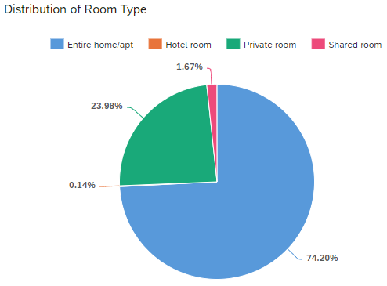

Pie Chart: Airbnb Popular Room Types

Slide 6
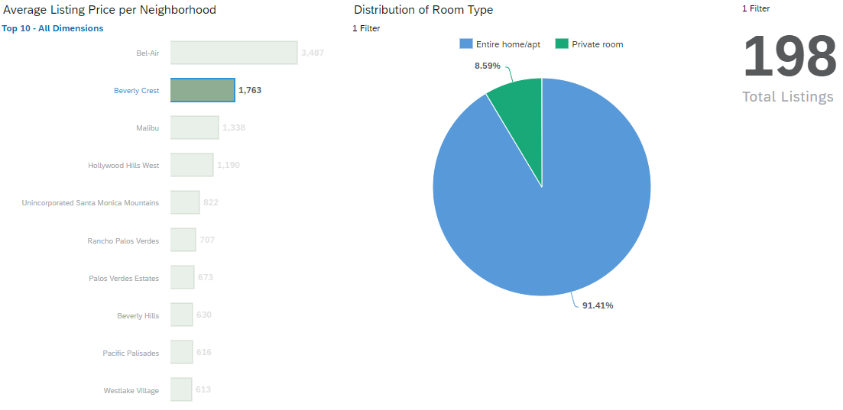
Linked Analysis

Slide 7
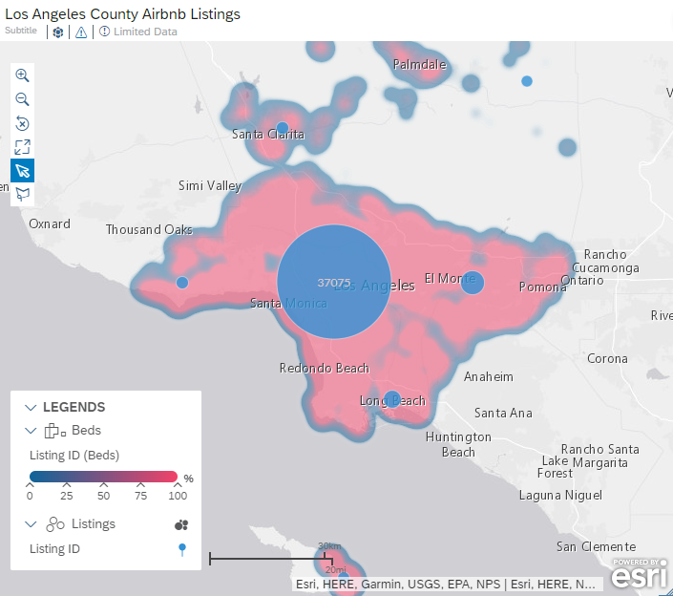
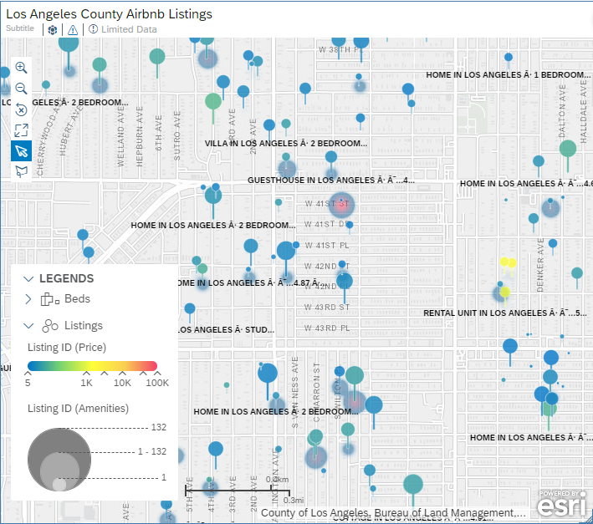
Geo Map: Listings in Los Angeles County

Slide 8
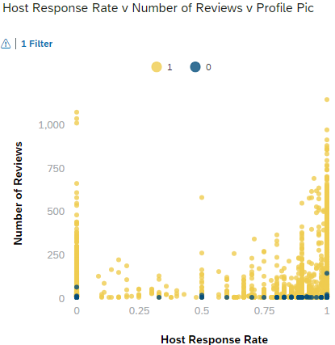
Scatterplot: Host Responses v Number of Reviews v Profile Pic
Picture
No Picture

Slide 9
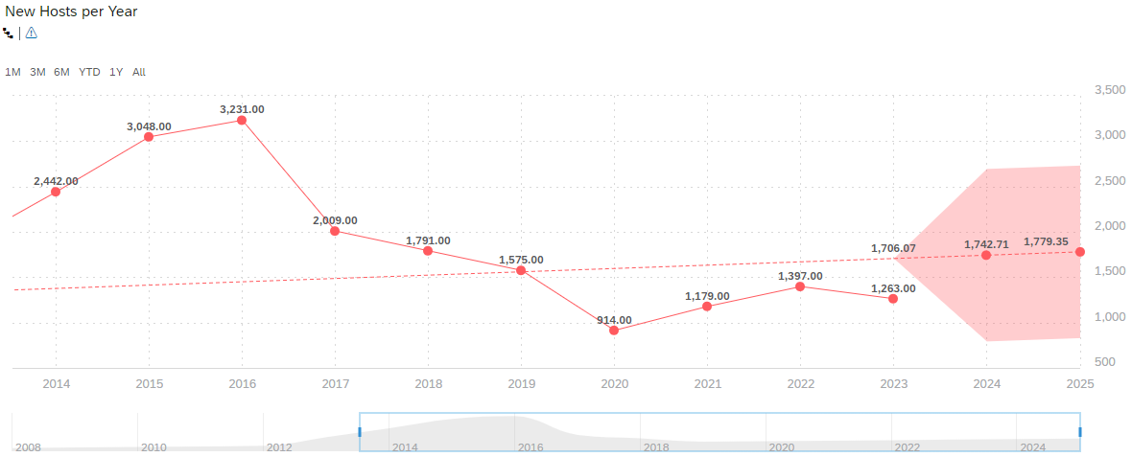
Time Series: New Hosts per Year

Slide 10
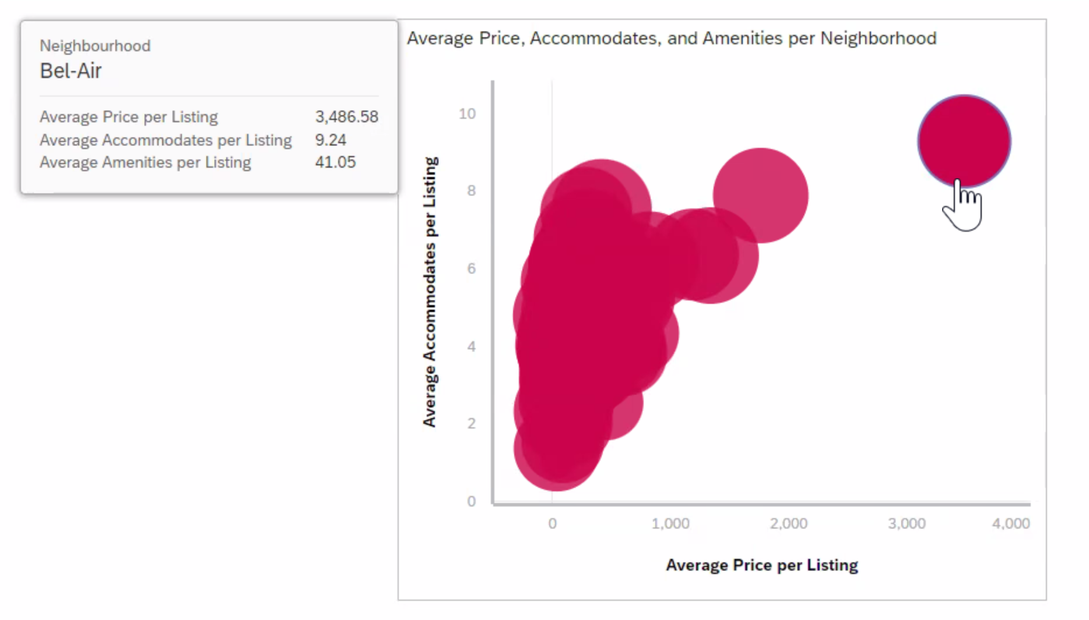
Bubble Graph: Average Price, Accommodations, and Amenities per Neighborhood

Slide 11
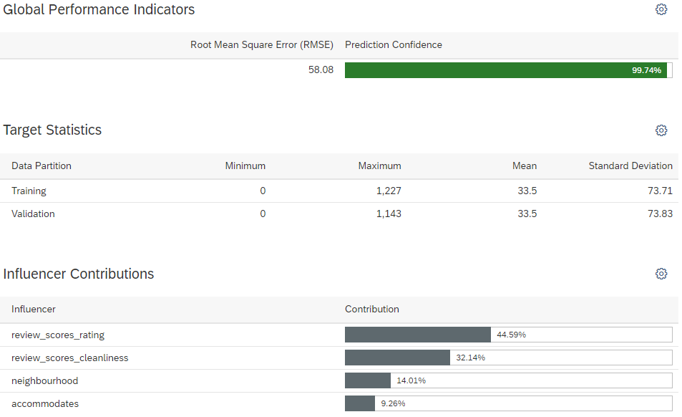
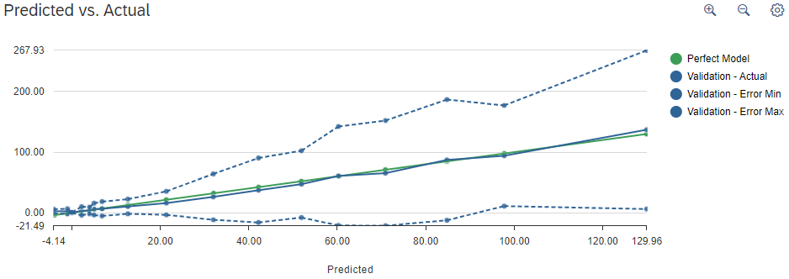
Regression Analysis: Bookings

Slide 12
Key Findings
Hosts with higher response rates and profile pictures tend to receive more reviews, indicating a positive correlation between response rate, profile picture presence, and review count. However, hosts with a high response rate but no profile picture receive fewer reviews.
Through the distribution of listings per room type, we observe that the majority of listings offered on Airbnb in Los Angeles County are entire homes or apartments.
Listings generally increase in price with more guests and amenities, although this trend may vary by location.
Hosts must consider factors like amenities, location proximity, and market trends when setting prices, as different neighborhoods offer varying price points.
The three primary factors influencing bookings are review scores, cleanliness scores, and neighborhood.

Slide 13
Links
GitHub: https://github.com/salazarjp/airbnbgroup4
Data Source: http://insideairbnb.com/get-the-data/
SAP Analytics Cloud: https://higher-education.us10.sapanalytics.cloud/sap/fpa/ui/tenants/81639#view_id=contentLib;resourceId=B9988A08D89F7BA8E5A912D5AB36BAA3;resourceType=FOLDER

Slide 14
Q & A

